Slide 1
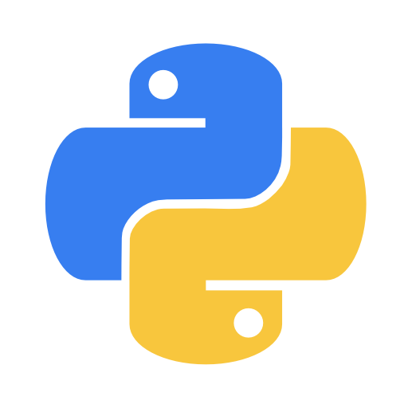
Functions In Python
f( )
They're pretty awesome.

Slide 2
Python Functions
Sometimes you'll have a block of code that you want to use multiple times, in many different places.

Slide 3
Python Functions
The code, written by someone else for the print() function is over 1000 lines long (In C). Imagine if you had to write 1000 lines everytime you wanted to print something!!!
Instead, all you have to do is call the print function because it has already been defined for you!

Slide 4
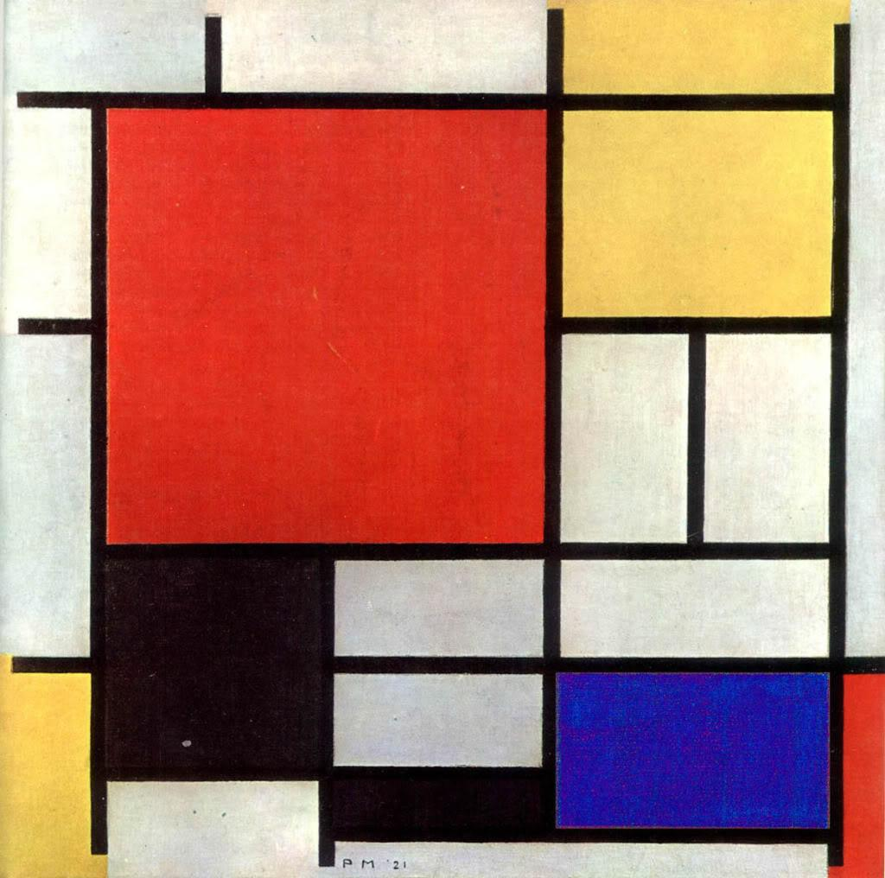
Python Functions
Functions are blocks of code that can be used in various places.

Slide 5
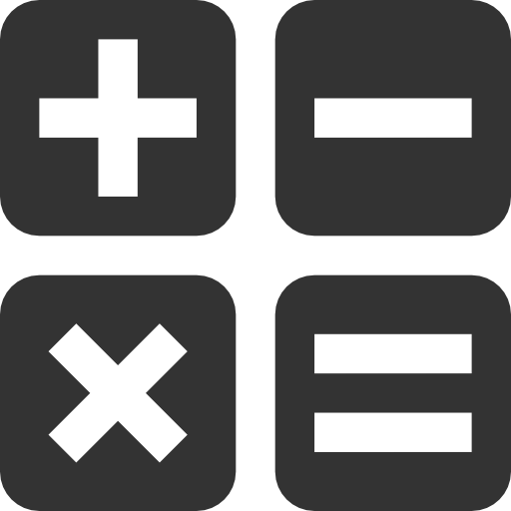
A bit of Mathematics
From your O’ Level mathematics, what is a function?

Slide 6
A bit of Mathematics
y = f(x)
f(x) = 2x + 9
? ?
y = **
?

Slide 7
A bit of Mathematics
y = f(x)
f(x) = 2x + 9
input processing
y = **
output

Slide 8
A bit of Mathematics
y = f(x)
f(2) = 2*(2) + 9
input processing
y = 13
output

Slide 9
A bit of Mathematics
y = f(x) = 2*x+9
f(1) = 2*(1) + 9
f(5) = 2*(5) + 9
f(7) = 2*(7) + 9
f(6) = 2*(6) + 9

Slide 10
A bit of Mathematics
f(x) = 2 + 7x
g(x) = 3x
f(g(3)) = ???
g(f(g(3))) = ???

Slide 11
Functions In Python
f( )
Let’s get busy!!!

Slide 12
f(x) = 6x + 9 This is called defining a function. We are defining how the function operates.
In python, we also define a function in the following manner:
def my_first_function(parameter):
#Put instructions here
#Everything that is indented is #inside the function
return #The answer here

Slide 13
Function Syntax
Parameter – The inputs to the function
Function keyword
(tells Python you’re now defining a function
Function
Name
def my_first_function(parameter):
#Put instructions here
#Everything that is indented is inside the function
return #return value
Return keyword, tells Python the answer it should give back and that the function ends here
Return Value – The answer

Slide 14
SIMPLIFY!!!!
f(x) = 6x + 9
In python, we also define this function in the following manner:
def f(x):
result = 6*x + 9
print(result)

Slide 15
Example 4.1: Maths futhi

Slide 16
A bit of Coding
Write a function that returns the USER’s age then call the function

Slide 17
ANSWER
def age():
return (int(input(“What is your age? “))
print(age())
Don’t forget to CALL the function otherwise it won’t do anything!!!

Slide 18
MORE…..
Write this code in your script and run it. What happens? Why?
def age():
return (int(input(“What is your age? “))

Slide 19
ANSWER
We only defined the function but we did not ask it to do anything.
If we want a function to work, we have to call it, e.g. “John, please come here!”

Slide 20
CORRECT ANSWER
def age():
return (int(input(“What is your age? “))
print(age())
These parentheses are the difference between a function and variable, never leave them even if they have nothing!!!!

Slide 21
Function Composition
The output from one function can be the input to another function. Putting a function inside a function is called composition. The function inside is called before the outside one
print(input(“Enter a number: ”))
input() is called before print() since it is inside print()

Slide 22
MORE…..
Write a function multi(y) that multiplies the age obtained from the function age() by two. Write a separate function printer(x) that will print the result of the multiplication.

Slide 23
def age():
return (int(input(“What is your age? “))
def multi(y):
print(2*y)
def printer(x):
print(2*y)
printer(multi(age()))

Slide 24
WHY DOESN’T IT WORK??

Slide 25
def age():
return int(input(“What is your age? “)
def multi(y):
return 2*y
def printer(x):
print(x)
printer(multi(age()))

Slide 26
CORRECT ANSWER
def age():
return int(input(“What is your age? “)
def multi(y):
return 2*y
def printer(x):
print(x) we only return if we want to use the obtained value, in this case we are not, we are printing
printer(multi(age()))

Slide 27
CORRECT ANSWER
def age():
return int(input(“What is your age? “)
def multi(y):
return 2*y
def printer(x):
print(x) we only return if we want to use the obtained value, in this case we are not, we are printing
printer(multi(age()))

Slide 28
Functions In Python
f( )
We’ve been using them all along!

Slide 29
CAN YOU NAME ANY FUNCTIONS YOU HAVE BEEN USING ALL ALONG?

Slide 30
EXAMPLES
print()
input()
int()
float()
str()
bool()
type()

Slide 31
OTHER FUNCTIONS
max(a,b,…..,z)
min(a,b,……,z)

Slide 32
EXAMPLES
max(1,2,4000,6000,6000.00000001)
min(4000,-2, 2,40, 99)
max(222,222.000001)
min(0,-0)

Slide 33
EXAMPLES
max(min(3000.01,2999.7,300,-4),max(400,3))
min(min(89,71,88,2),2,9,max(4,8,9),min(7,8,3))
max(222,222.000001)
min(0,-0)

Slide 34
Example 4.3: But I did programming to avoid compositions

Slide 35
‘’’ Doc String In Python ‘’’
f( ):
We’ve been using them all along!

Slide 36
EXAMPLE
TYPE THIS INTO YOUR SHELL:
help(print)
What you see printed there is the Documentation String. It describes what the function does

Slide 37
EXAMPLE
def multi(y):
‘’’
Input any number y
Function multiplies y by 2
Returns a float or integer
‘’’
return(2*y)

Slide 38
EXAMPLE
Run the script where you define multi()
In the shell, type in: help(multi)
You should see the Doc String you wrote down.

Slide 39
Example 4.2: How do functions function

Slide 40
Difference between return and print
print() prints to screen and throws away the answer
return gives the answer to you so that you can print, give it to another function (composition) or store it in a variable

Slide 41
Example 4.4: Putting it all together

Slide 42
Read Chapter 4
Questions?

